Slide 1
Biodiversity in National Parks
Sam Norton

Slide 2
Animal and plant species in U.S. national parks
This data set contains the class, scientific name, common names and conservation status of 5541 unique individual species
Of this group:
151 species are of concern
10 species are threatened
15 species are considered endangered
4 species are in recovery
The remaining 5363 are not of concern

Slide 3
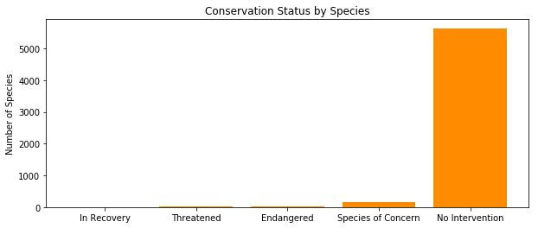
Most species in the sample population are not at risk of disappearing from these parks

Slide 4
Which taxonomic class is more likely to be endangered?
Mammals are significantly more likely to be endangered than reptiles
However, there is no significant difference between the frequencies of endangered birds and endangered mammals.

Slide 5
It is therefore recommended that conservationist pay close attention to birds and mammals to help preserve these populations in the national parks.

Slide 6
Study of Sheep populations in U.S. national parks

Slide 7
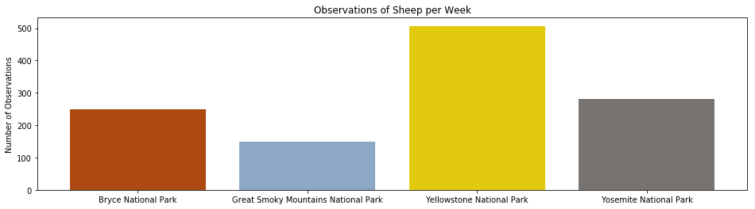
Yellowstone park has the greatest observed number of sheep

Slide 8
Foot and mouth in sheep populations in U.S. national parks
A recent program has been introduced to these national parks to reduce foot and mouth incidence.
Past rates showed 15% of sheep being infected
It has been determined that a 5% point reduction in this rate would demonstrate that the new program is effective

Slide 9
Study Design
520 individual sheep assessments are required to detect a 5% point decrease from 15%.
At Yellowstone park this can be completed within just one week
At Bryce national park this will take just over two weeks to complete (2 weeks, 1 day)

Slide 10
It is hoped that this new intervention will successfully reduce foot and mouth rates in these national parks

